Slide 1
3D PRINTING
a way to create
K. PAVAN KARTHEEK

Slide 2
Introduction
3D printing process builts a three dimensional object from a CAD model.
It is not even the latest technology, it is from 1970’s.
The term "3D printing" covers a variety of processes in which material is joined or solidified under computer control to create a three-dimensional object with material being added together typically layer by layer.
In 1974, David E. H. Jones laid out the concept of 3D printing in his regular column Ariadne in the journal New Scientist
In the late 1990’s 3D printing is considered only for rapid prototyping.
In present state 3D printing is in various domains including rapid prototyping.
The term "3D printing" originally referred to a process that deposits a binder material onto a powder bed with inkjet printer heads layer by layer.

Slide 3
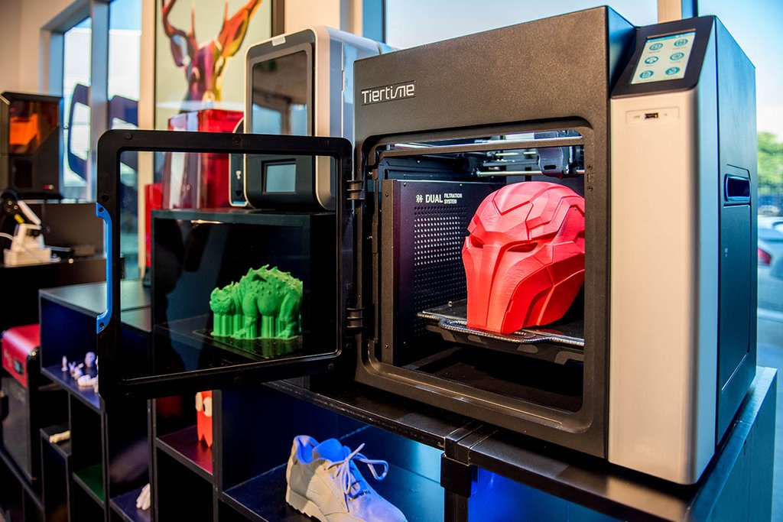
Basic 3d printer

Slide 4
Types of 3D printing

Slide 5
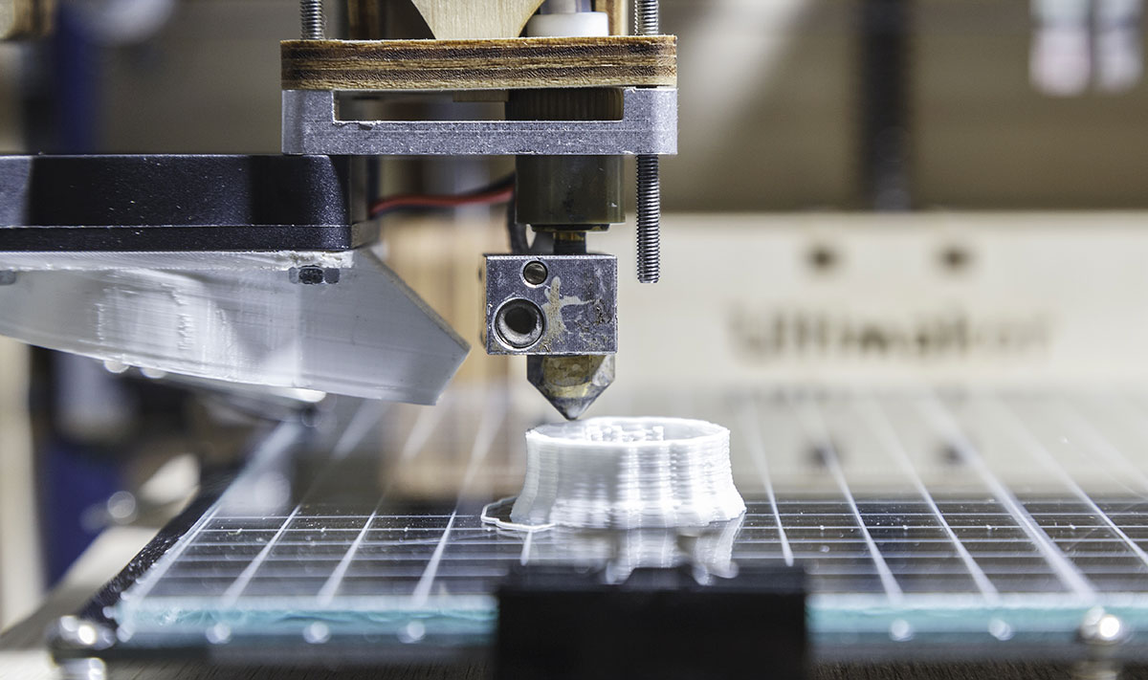
Additive manufacturing
Additive manufacturing is the official industry standard term (ASTM F2792) for all applications of the technology.
It is defined as the process of joining materials to make objects from 3D model data, usually layer upon layer, as opposed to subtractive manufacturing methodologies.
Wastage of time, money and material is very low when compared to subtractive manufacturing.

Slide 6
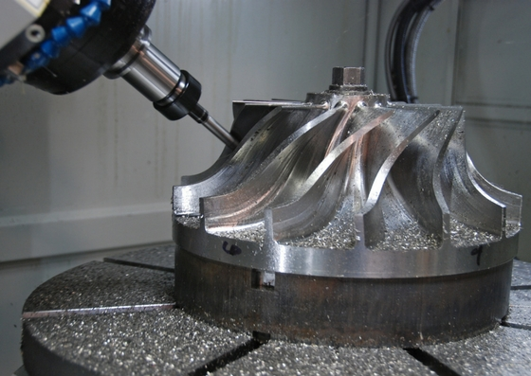
Subtractive manufacturing
Subtractive manufacturing is any of various processes in which a piece of raw material is cut into a desired final shape and size by a controlled material-removal process.
Subtractive manufacturing can be done by manually cutting the material but is most typically done with a CNC Machine.
Advanced CNC machines utilize multiple tools and cut around at least three (x, y, and z) axes such that they minimize the requirement for designers to flip the block.

Slide 7
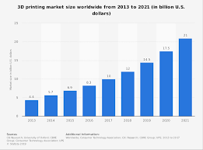
evolution in 3D printing

Slide 8
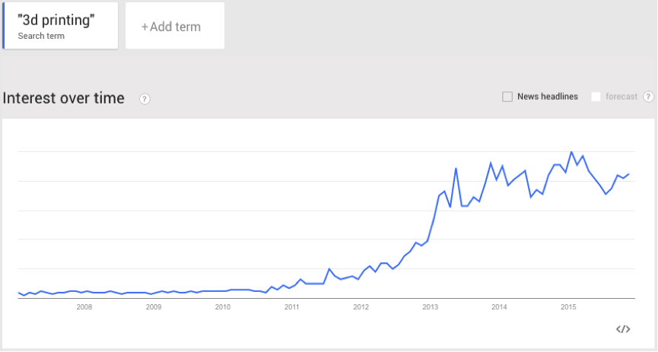
The interest in 3D printing over the last 5years has increased

Slide 9
Interest in 3d printing

Slide 10
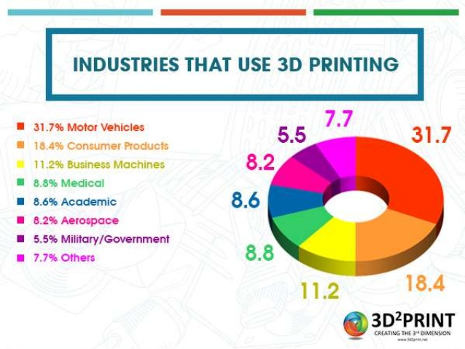

Slide 11
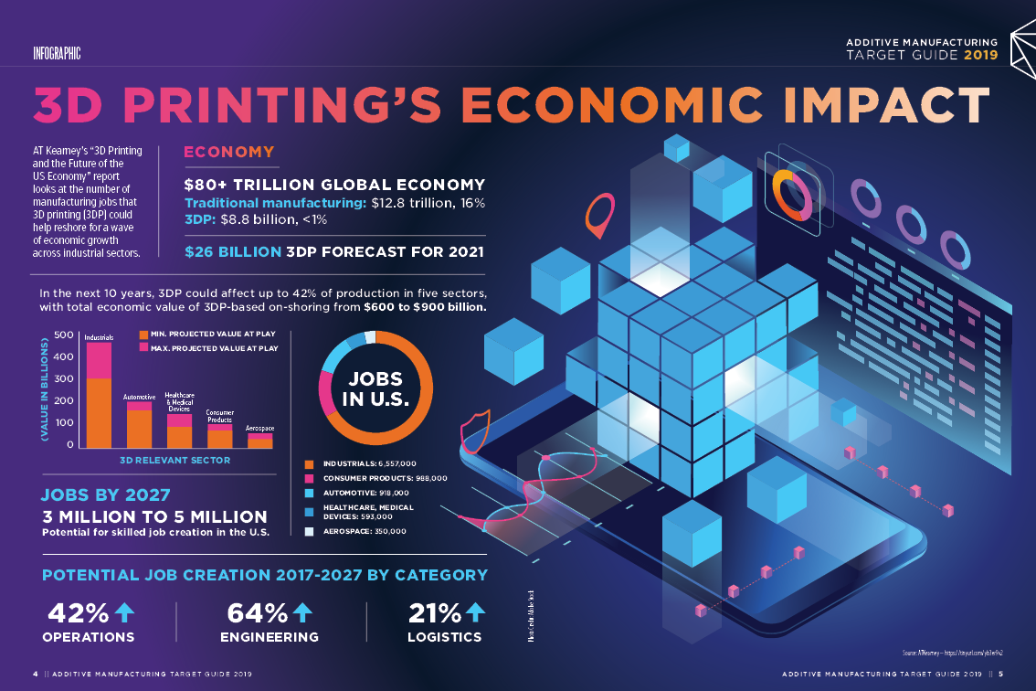
Rapid development in job opportunities and income

Slide 12
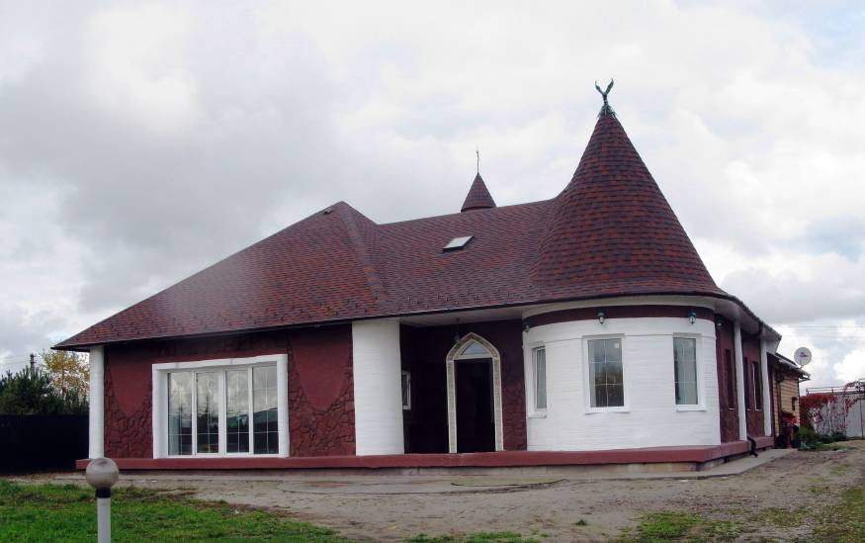
3D printing is the sector which replaces the olden constructional sector.
Jobs provided are more when compared to jobs lost.

Slide 13
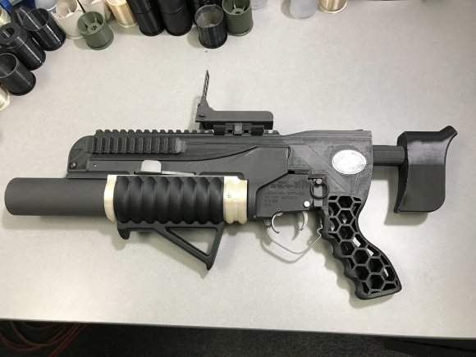
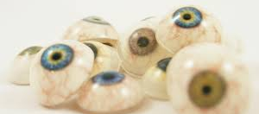
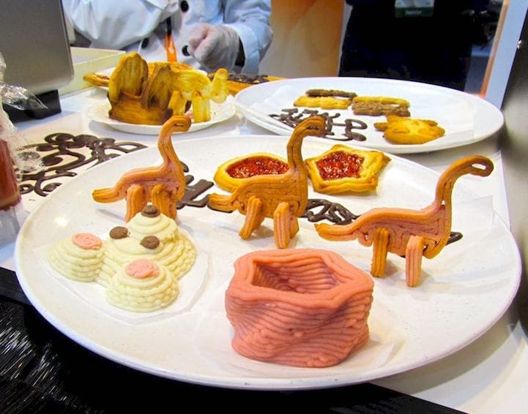
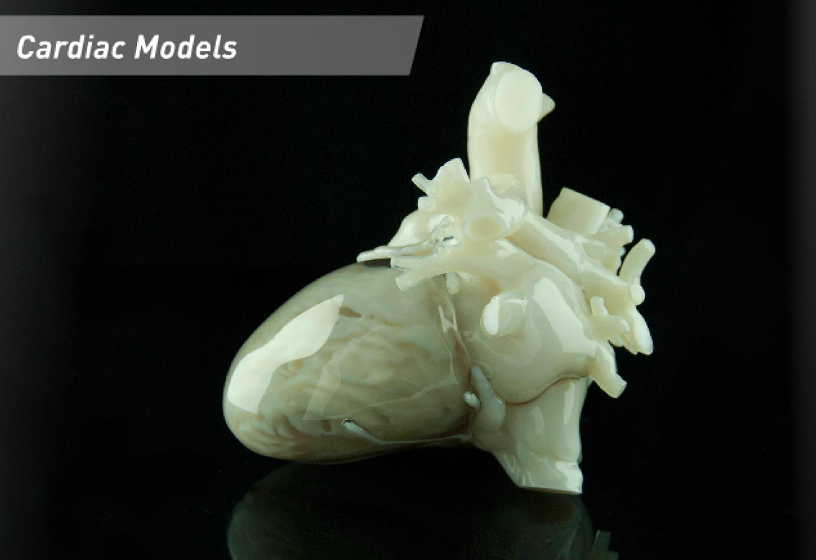
Examples
Medical
Food
Army

Slide 14
Conclusion
3D printing technology could revolutionize and re-shape the world. Advances in 3D printing technology can significantly change and improve the way we manufacture products and produce goods worldwide.

Slide 15
Thank you

